Slide 1

Year 1 Phonics Information Meeting

Slide 2
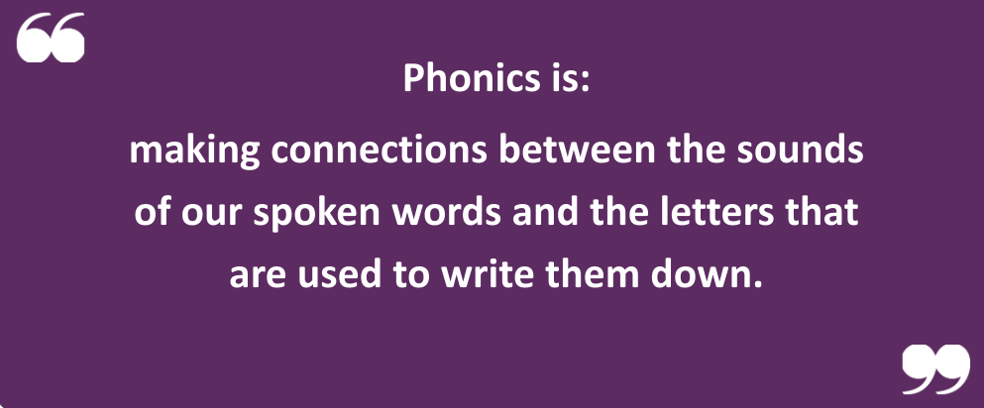

Slide 3
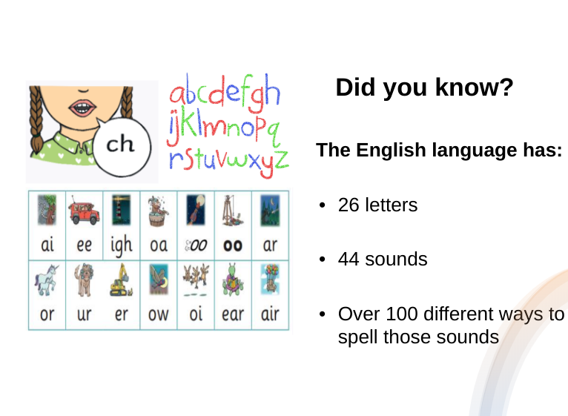

Slide 4
How do we teach phonics?
We use a phonics program called ‘Little Wandle’ to teach phonics to our pupils.
This consists of:
Daily, short lessons
Repeated practice – previously taught sounds are revisited at the start of each session and opportunities for repeated practice are built into the school day.
We follow a specific order of teaching
A typical lesson will teach a new phoneme and the grapheme that represents that phoneme. Children will practise applying their phonics through blending for reading and segmenting for writing.

Slide 5
Little Wandle provides excellent training for all staff to ensure consistency.
Reading development is a priority at Hertford St Andrew and we have ensured dedicated time to support children needing additional support. These children are quickly identified and daily keep up sessions are provided.

Slide 6
Top tips for supporting phonics at home
Display PGCs at home and refer to them often.
Listen to your child read as often as possible and enjoy sharing story books together.
Ask your child what they have learnt in phonics and ask them to show you their amazing writing.
Build their self esteem and interest in reading by encouraging them to read to other family members. Lots of praise is vital!
Encourage your child to say each sound clearly. For example “mmmm” instead of “mu.”

Slide 7
Reading

Slide 8
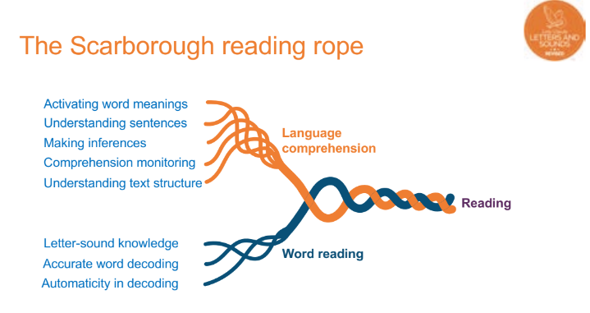
Dr. Hollis Scarborough, a literacy expert and psychologist created the Scarborough reading rope in 2001

Slide 9
Supporting language comprehension at school
We value oracy and want our children to communicate effectively through spoken language. We have incorporated 10 minutes into our curriculum every day for every child to develop their ability to speak clearly and confidently as well as being able to listen and respond appropriately and use a wide range of vocabulary.
Curiosity is one of our school’s core values. Children are actively encouraged to ask questions and are praised for doing so.
We provide high quality texts which are rich in vocabulary and ideas.
Our school has communication friendly spaces inside and out.

Slide 10
How to support your child's language comprehension at home
Read together
Play games
Sing and rhyme
Have conversations
Describe the things you see
Ask questions and encourage your child to ask questions, praising their curiosity.
Model good speech
Give your child time to think - for open questions we suggest up to 15 seconds.

Slide 11
Supporting ‘word reading’ at school
Every day after your child’s phonics lesson, they will have a ‘reading practice’ session.
During this lesson they will be supported by a trained adult and will be reading a book closely matched to their phonic ability.
Children read the same book throughout the week so as to build fluency.
Fluency enables children to read with accuracy, automaticity and prosody.

Slide 12
Robert borrowed my new bicycle.

Slide 13
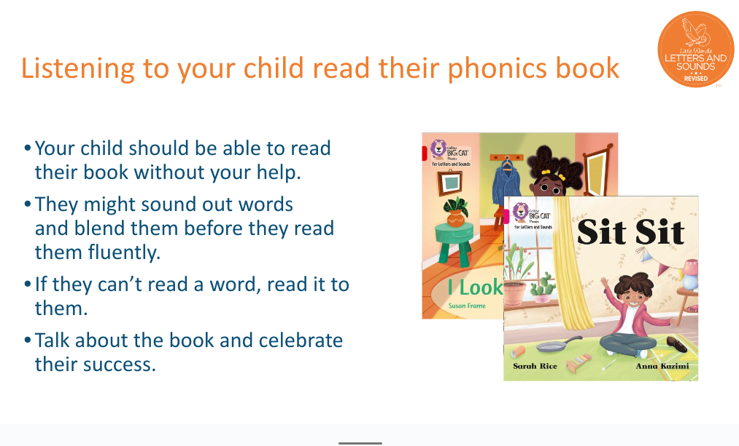

Slide 14
Reading for pleasure

Slide 15
National Literacy Trust study
Not reading at the expected level puts children at an increased risk of experiencing unemployment and poor health as adults.
Strong reading skills have been shown to improve children’s academic attainment across a range of subjects, including English, maths and science.
Just 2 in 5 (43.4%) children and young people aged 8 to 18 said they enjoyed reading in 2023. This is the lowest level since we first asked the question in 2005.

Slide 16
Benefits of reading with your child
Provides comfort and reassurance.
Increases confidence and security.
Promotes relaxation.
Giving a child time and full attention when reading them a story tells them they matter. It builds self-esteem.
Builds vocabulary.
Feeds their imagination
Improves their sleeping patterns.
Reading can reduce stress levels by up to 68% in as little as six minutes. Reading slows your heart rate, lowers your blood pressure, and relaxes your muscles

Slide 17
